Slide 1
Natural Language Processing in Recognizing Similar Texts
P.Hema Sundara Rao(192225102)
K.Yerriswamy(192225106)

Slide 2

ABSTRACT
Identifying similar texts helps in recognizing synonymous phrases and understanding the contextual similarity between different documents.
Text similarity is used to generate text similar in style or meaning to a given text, identify synonyms, and assess the similarity of documents in natural languages.
It enables us to quantify the closeness between two pieces of text and is vital for various language processing applications.

Slide 3
Natural Language Processing
systems can effectively recognize similarities for various applications such as plagiarism detection, document retrieval, recommendation systems, question answering, and sentiment analysis.
The choice of approach depends on factors like the nature of the text data, available resources, and the desired level of accuracy and interpretability.

Slide 4
Importance of Text Similarity Recognition
Recognizing similar texts is crucial for numerous real-world applications
Content Recommendation: Recommending similar articles, products, or services based on user preferences.
Search and Retrieval: Enhancing search engines by retrieving relevant documents or information.
Question Answering: Matching user queries with relevant answers from vast knowledge bases.

Slide 5

Methodology
NLP in recognizing similar texts encompasses various reprocessing steps, representation techniques, similarity metrics, semantic understanding, deep learning approaches, ensemble techniques, and evaluation methodologies.

Slide 6
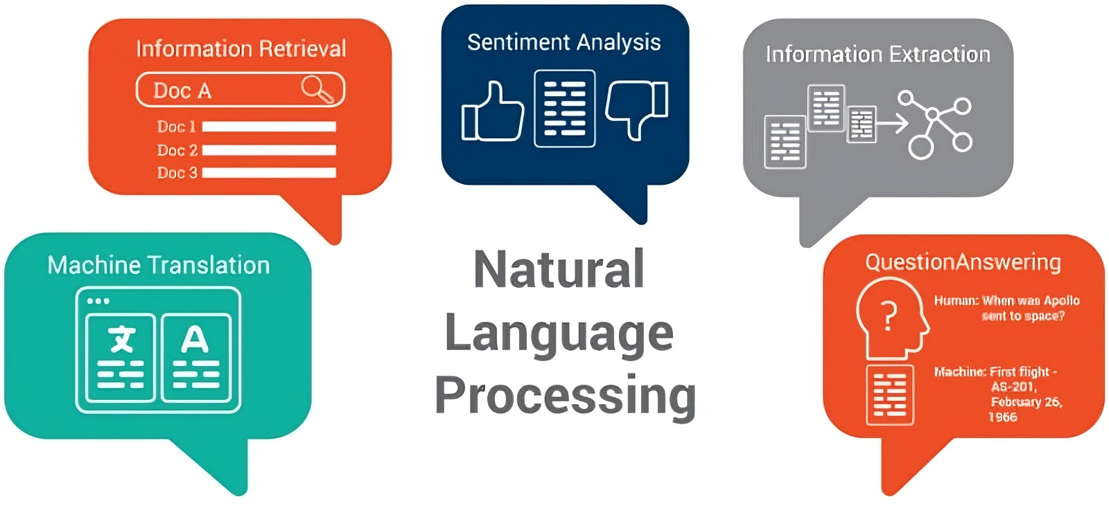
Algorithm depends on the specific requirements of the text similarity task, including the size of the dataset, the computational resources available, and the desired accuracy and interpretability of the results.
Text Preprocessing
Text Representation
Similarity Metrics
Semantic Understanding

Slide 7
Advantages Disadvantages
Efficiency
Automation
Scalability
Semantic Understanding
Adaptability
Complexity
Data Quality
Domain Specificit
Ambiguity
Ethical Concerns

Slide 8
Test cases and Result
Test Case 1:
Input: Two identical documents.
Expected Result: The NLP algorithm should identify a high degree of similarity between the two documents, indicating that they are identical.
Test Case 2:
Input: Two documents with similar content but different wording.
Expected Result: The NLP algorithm should recognize the semantic similarity between the documents, despite variations in wording, and indicate a moderate to high degree of similarity.

Slide 9
Conclusion
Natural Language Processing (NLP) plays a pivotal role in recognizing similar texts across various domains and applications. Through the utilization of sophisticated algorithms and techniques, NLP enables the identification of textual similarities, facilitating tasks such as plagiarism detection, document retrieval, content recommendation, and more.

Slide 10
Thank You

